Slide 1
Social Media and Juror Misconduct
Joseph Story
Inn of Court

Slide 2
Seniors 66+ Baby Boomers 45-64 Gen X 35-44 Millennial/Gen Y 18-34
GENERATIONAL CHARACTERISTICS

Slide 3
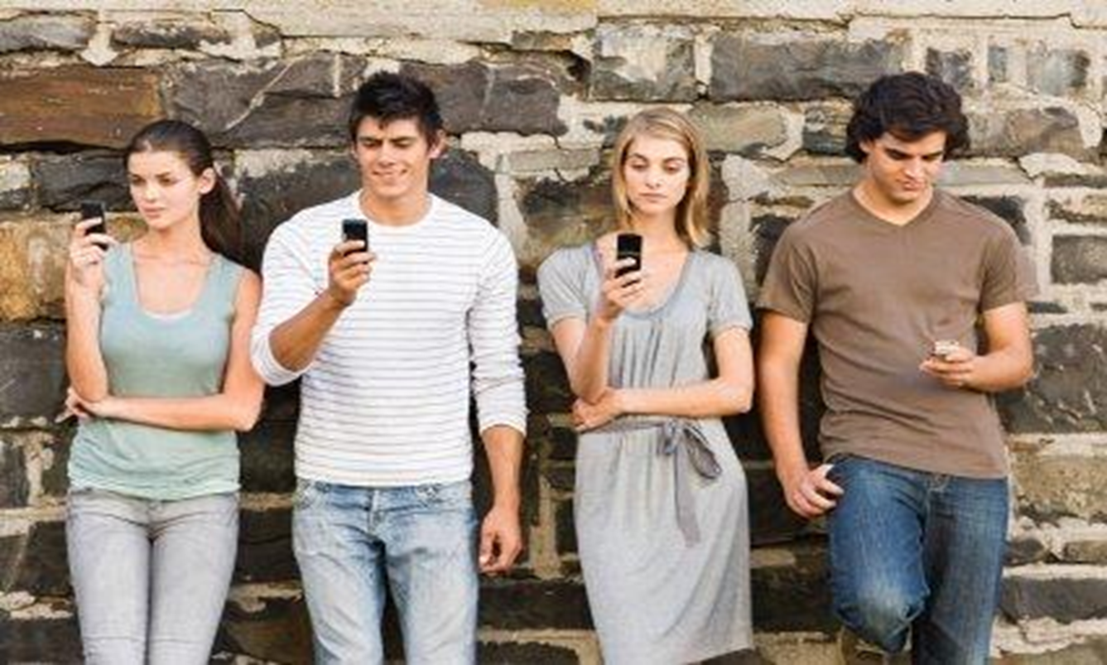
Disclaimer
The following are generalizations based upon large segments of society. Individual life experiences, biases, and personalities have more impact than generalities alone.

Slide 5
Violence: Columbine and other mass shootings, 9/11 War on Terror Corporate Scandals: Enron, financial meltdown
LIFE EVENTS

Slide 6
Have always known computers, cell phones, and the Internet. Constantly communicating via text messaging and social networks, impatient, used to receiving information with a few keystrokes on devices, completely tech savvy, and expect technology to be clear and in sound bites. Shortened attention span, zone out during monologues, product of helicopter parents/hovered over, everything planned.
GEN Y CHARACTERISTICS

Slide 7
Impact upon jury experience: expect technology to be used during the trial, just as they do in daily life. Diversity is the norm, know how to get along with fellow jurors of all ages, race and gender. Value personal responsibility, fiscally conservative, yet where liability is clear and injury severe, they will award extensive damages Emotional appeals leave them skeptical, suspicious, and uncomfortable They expect lawyers to deceive them/manipulate them Visual learners; expect show, not tell; teach, not preach

Slide 8
Pitfalls: will use technology during trial, Google defendants, locations, witnesses, experts Use of text messaging and social media is so pervasive, there is no realization of impropriety.

Slide 9
Report from jury duty: Defendant looks like a murderer. Guilty. Waiting for opening remarks. #iftheglovedon’tfit
True or False?

Slide 10
False

Slide 11
“Jury duty today. Stupid jury duty!” Response: “Throw the book at ‘em.”

Slide 12
True

Slide 13
“Waiting to be selected for jury duty. I don’t feel impartial.” Reply: “Nothing like sticking it to the jury confidentiality clause…just send her to prison quickly so you can be home in time for dinner.”

Slide 14
True

Slide 15
Commonwealth v. Werner, 81 Mass. App. 689 (2012) Trial judge denies defendant’s motion for a new trial. Affirmed or reversed?

Slide 16
Jurors had not been subjected to extraneous influence because of the Facebook postings.
Affirmed.

Slide 17
“Guy I thought was up for murder turns out to be defense attorney. I bet he murdered someone anyway.”

Slide 18
False

Slide 19
“I guess all I need to know is GUILTY. ”
LOL

Slide 20
True

Slide 21
Shaw v. State, 2013 WL 5533080, 2013 Miss. App. Lexis 662 (October 8, 2013)
Juror contacted 3 trial witnesses on Facebook with that comment. Trial court denies motion for mistrial.
Affirmed or reversed?

Slide 22
Affirmed.
Trial judge thoroughly questioned juror regarding his contact and promptly removed him from the jury. Remaining jurors polled by the trial judge all stated the juror had not made any positive or negative comments regarding the witnesses and that they could be fair and impartial.

Slide 23
“Attorneys presenting ‘evidence.’ Since when are security photos, DNA, and testimony evidence? Trusting my intuition.”

Slide 24
False

Slide 25
Juror: “Not sure if you recognize me or not. I thought you did a great job today on the witness stand. You really explained things so great.”
Witness: “I was thinking that was you. There is a risk of a mistrial if that gets out.”

Slide 26
True

Slide 27
State v. Smith, 2012 Tenn. Crim. App. LEXIS 165 (September 10, 2013) Trial judge informs attorneys of the communication. Verdict of guilty. Motion for new trial denied.
Affirmed or reversed?

Slide 28
When communications between a juror and a third party are brought to a trial court’s attention, the trial court must immediately inform the parties and conduct a hearing on the record to establish the nature and extent of the improper communications and whether the communications affect the outcome of the trial. Case remanded for such a hearing.
Reversed

Slide 29
Report for jury duty: Defendant looks like a murderer. Guilty. Waiting for opening remarks.
Guy I thought was up for murder turns out to be defense attorney. I bet he murdered someone anyway.
Attorneys representing ‘evidence’. Since when are security photos, DNA, and testimony evidence? Trusting my intuition.

Slide 31
Do not use any electronic device in any way for discovery or share any information about this case. This includes cell phones, Blackberries, computers, and other electronic devices. This includes searching, blogging, e-mailing, texting, using Facebook, Twitter, MySpace, LinkedIn, or any similar social network. NJI2d Civ. 1.00

Slide 32
SPECIFIC EXPLANATION
Time spent in preparing for trial; possibility the information on the Internet is false.
Knowledge of the court and parties of this information and efforts to keep it from the jury are thereby thwarted.

Slide 33
FEDERAL COURT PROPOSED INSTRUCTION
Many of you use cell phones, Blackberries, Internet, and other tools of technology . . . You may not communicate with anyone about this case on your cell phone, through e-mail, Blackberry, iPhone, text messaging, or on Twitter, through any blog or website, including Facebook, Google+, MySpace, LinkedIn, or You Tube. You may not use any similar technology of social media, even if I have not specifically mentioned it here. I expect you will inform me as soon as you become aware of another juror’s violation of these instructions.

Slide 34
At the close of the case you may not use any electronic device or media, such as the telephone, cell phone, a smart phone, iPhone, Blackberry, or computer, Internet, any Internet service, any text or instant message service, Internet chat room, blog, or website, such as Facebook, MySpace, LinkedIn, You Tube or Twitter to communicate to anyone any information about this case or to conduct any research about this case until I accept your verdict…
Proposed model jury instruction on the use of electronic technology, June 20, 2012
You may not use any of these electronics means to investigate or communicate about the case because it is important that you decide the case based solely on the evidence presented in this courtroom. Information on the internet or available through social media might be wrong, incomplete, or inaccurate.

